Slide 1
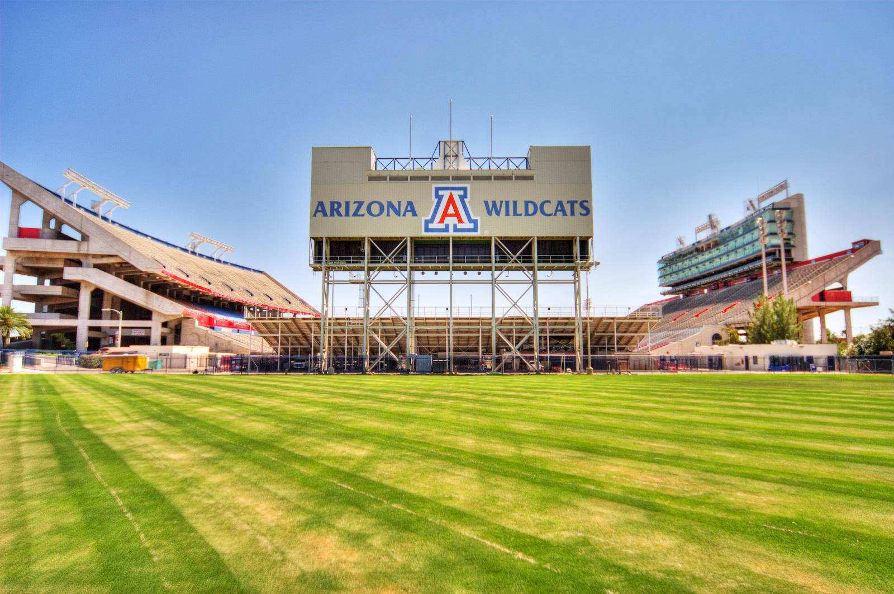



Using Life Cycle Assessment to Assess and Reduce the Footprint of ‘Mega-Events’ at the University of Arizona
Leah Edwards
Jake Knight, UA Office of Sustainability
Mentors: Dr. Joe Abraham and Dr. Paul Blowers
Notes:
Fonts used:
Archer
Berkeley
Friz Quadrata
Hel Neue Cond
Ideal Sans
Sentinal

Slide 2
Problem Statement
Many athletic venues have worked to reduce impacts of events, but not in a comprehensive way
  Generally only focused on one aspect of impact
  First large-scale assessment- 60,000 people
Importance of Quantifying
  Easier to ensure changes are effective

Slide 3
Objectives
Quantify environmental impacts associated with Homecoming 2012 and 2013
Identify ways to mitigate impact
Implement reduction strategies between 2012 and 2013
Make framework transferable and flexible

Slide 4
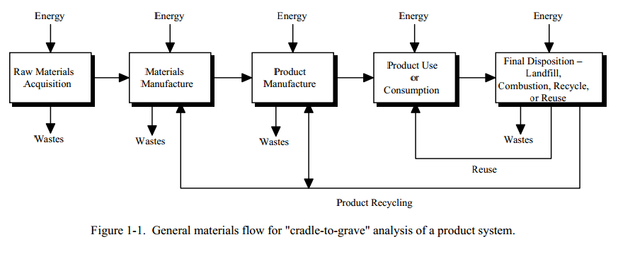
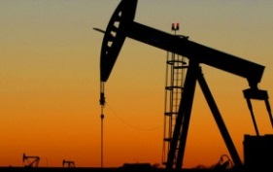
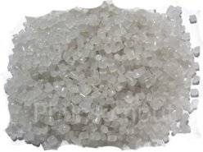
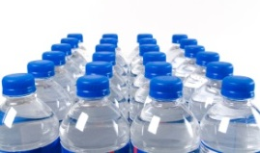

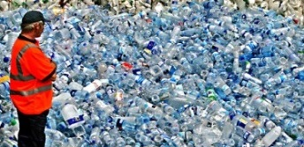
Concept of a Life Cycle Assessment
Bottled Water
Adapted from http://www.deq.state.or.us/lq/pubs/docs/sw/LifeCycleAssessmentDrinkingWaterReportOnly.pdf

Slide 5
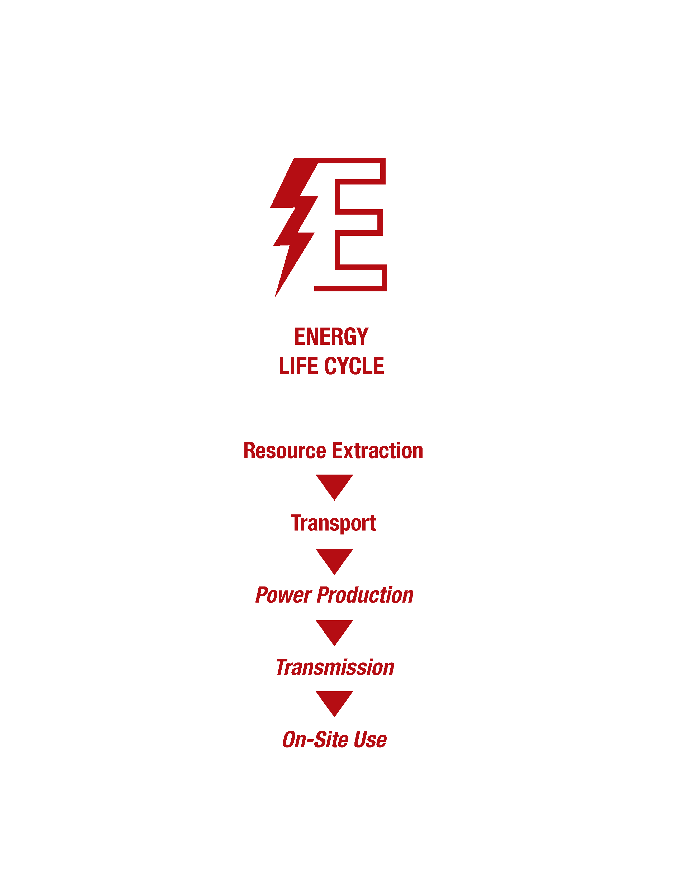
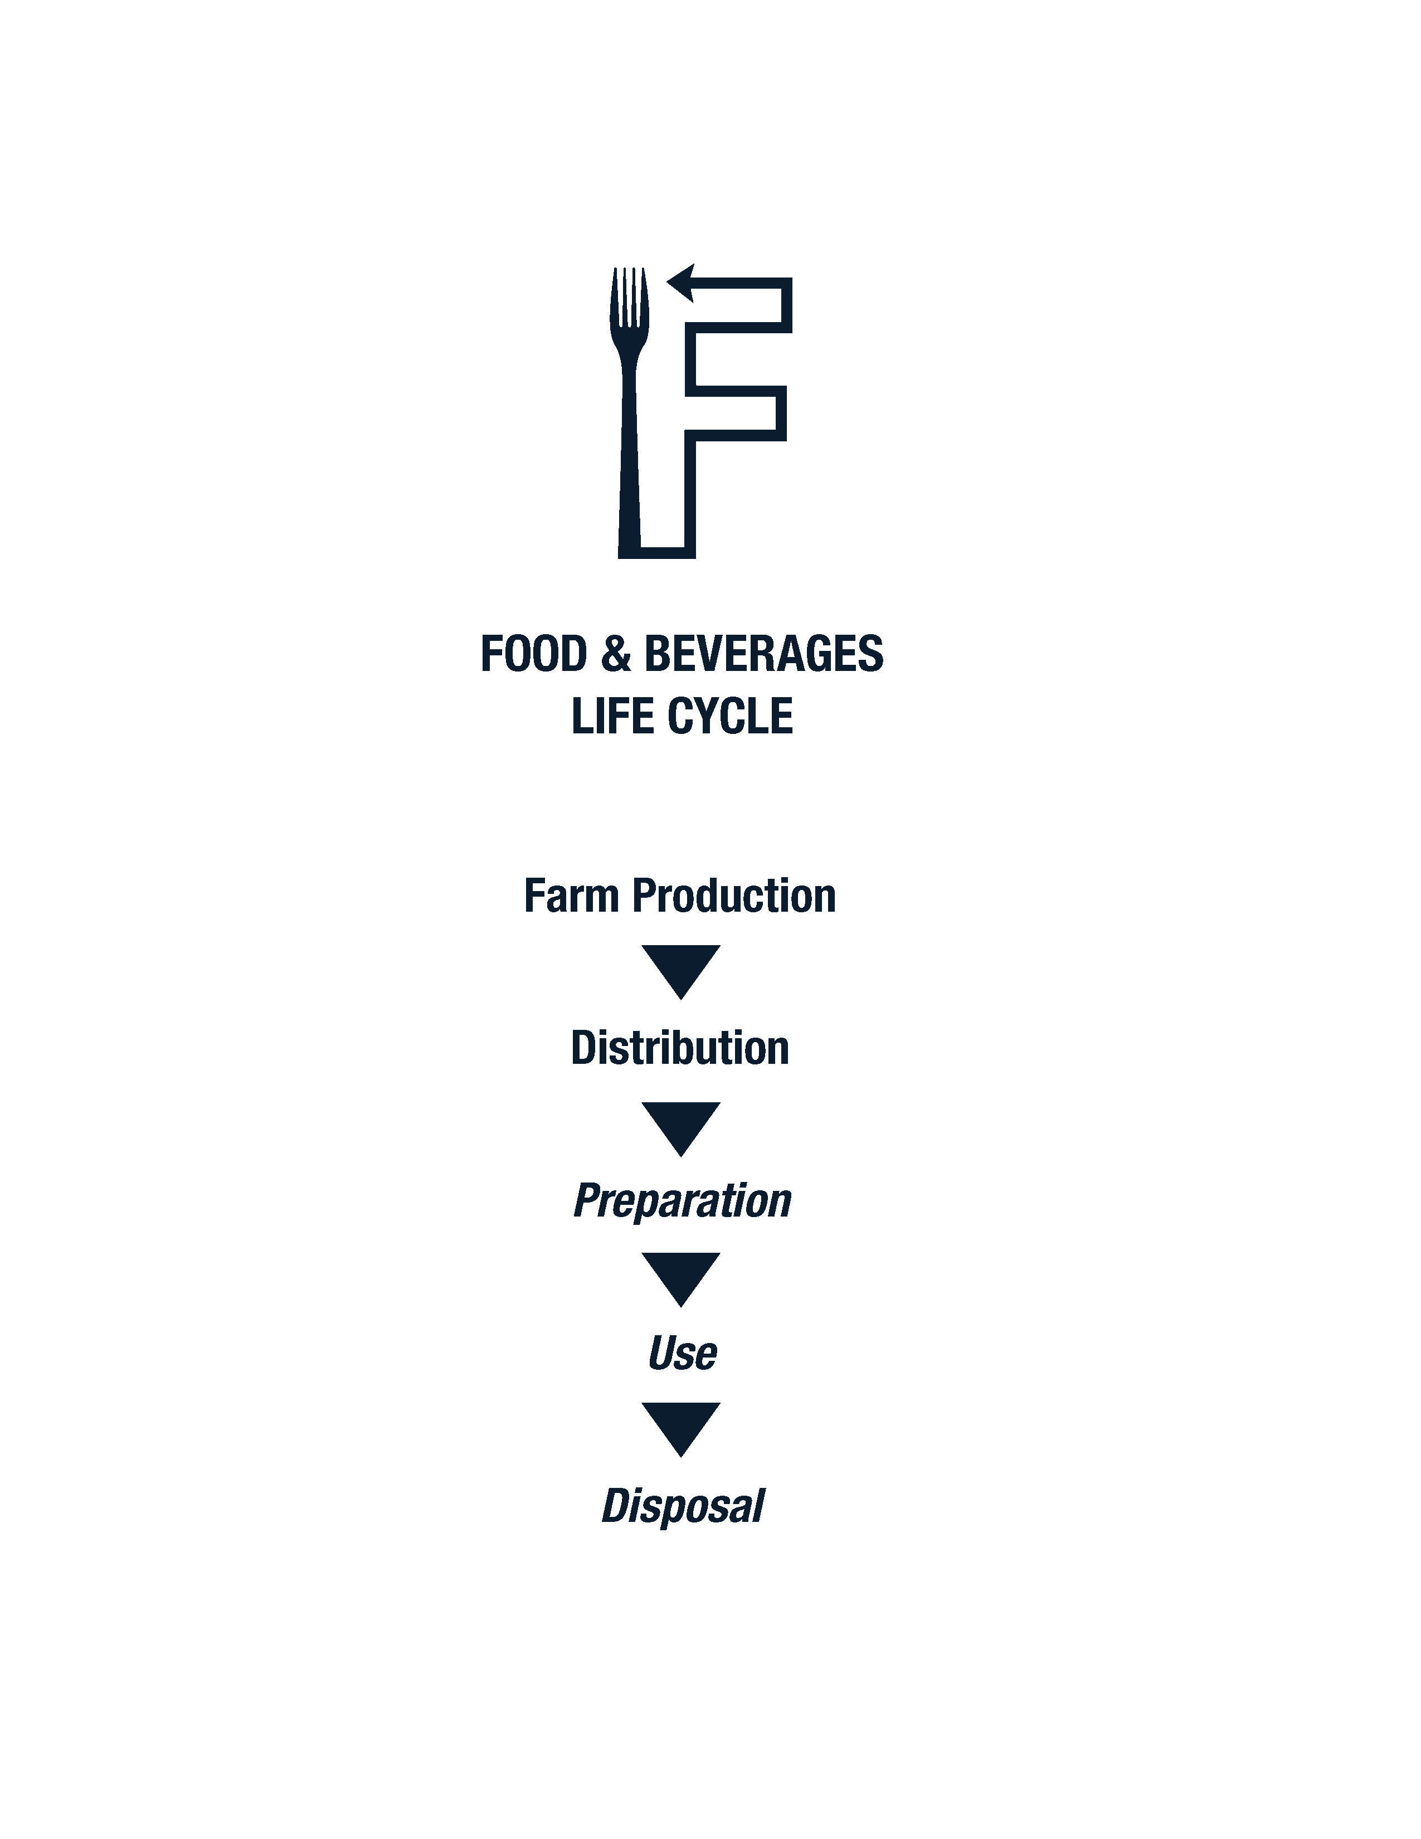
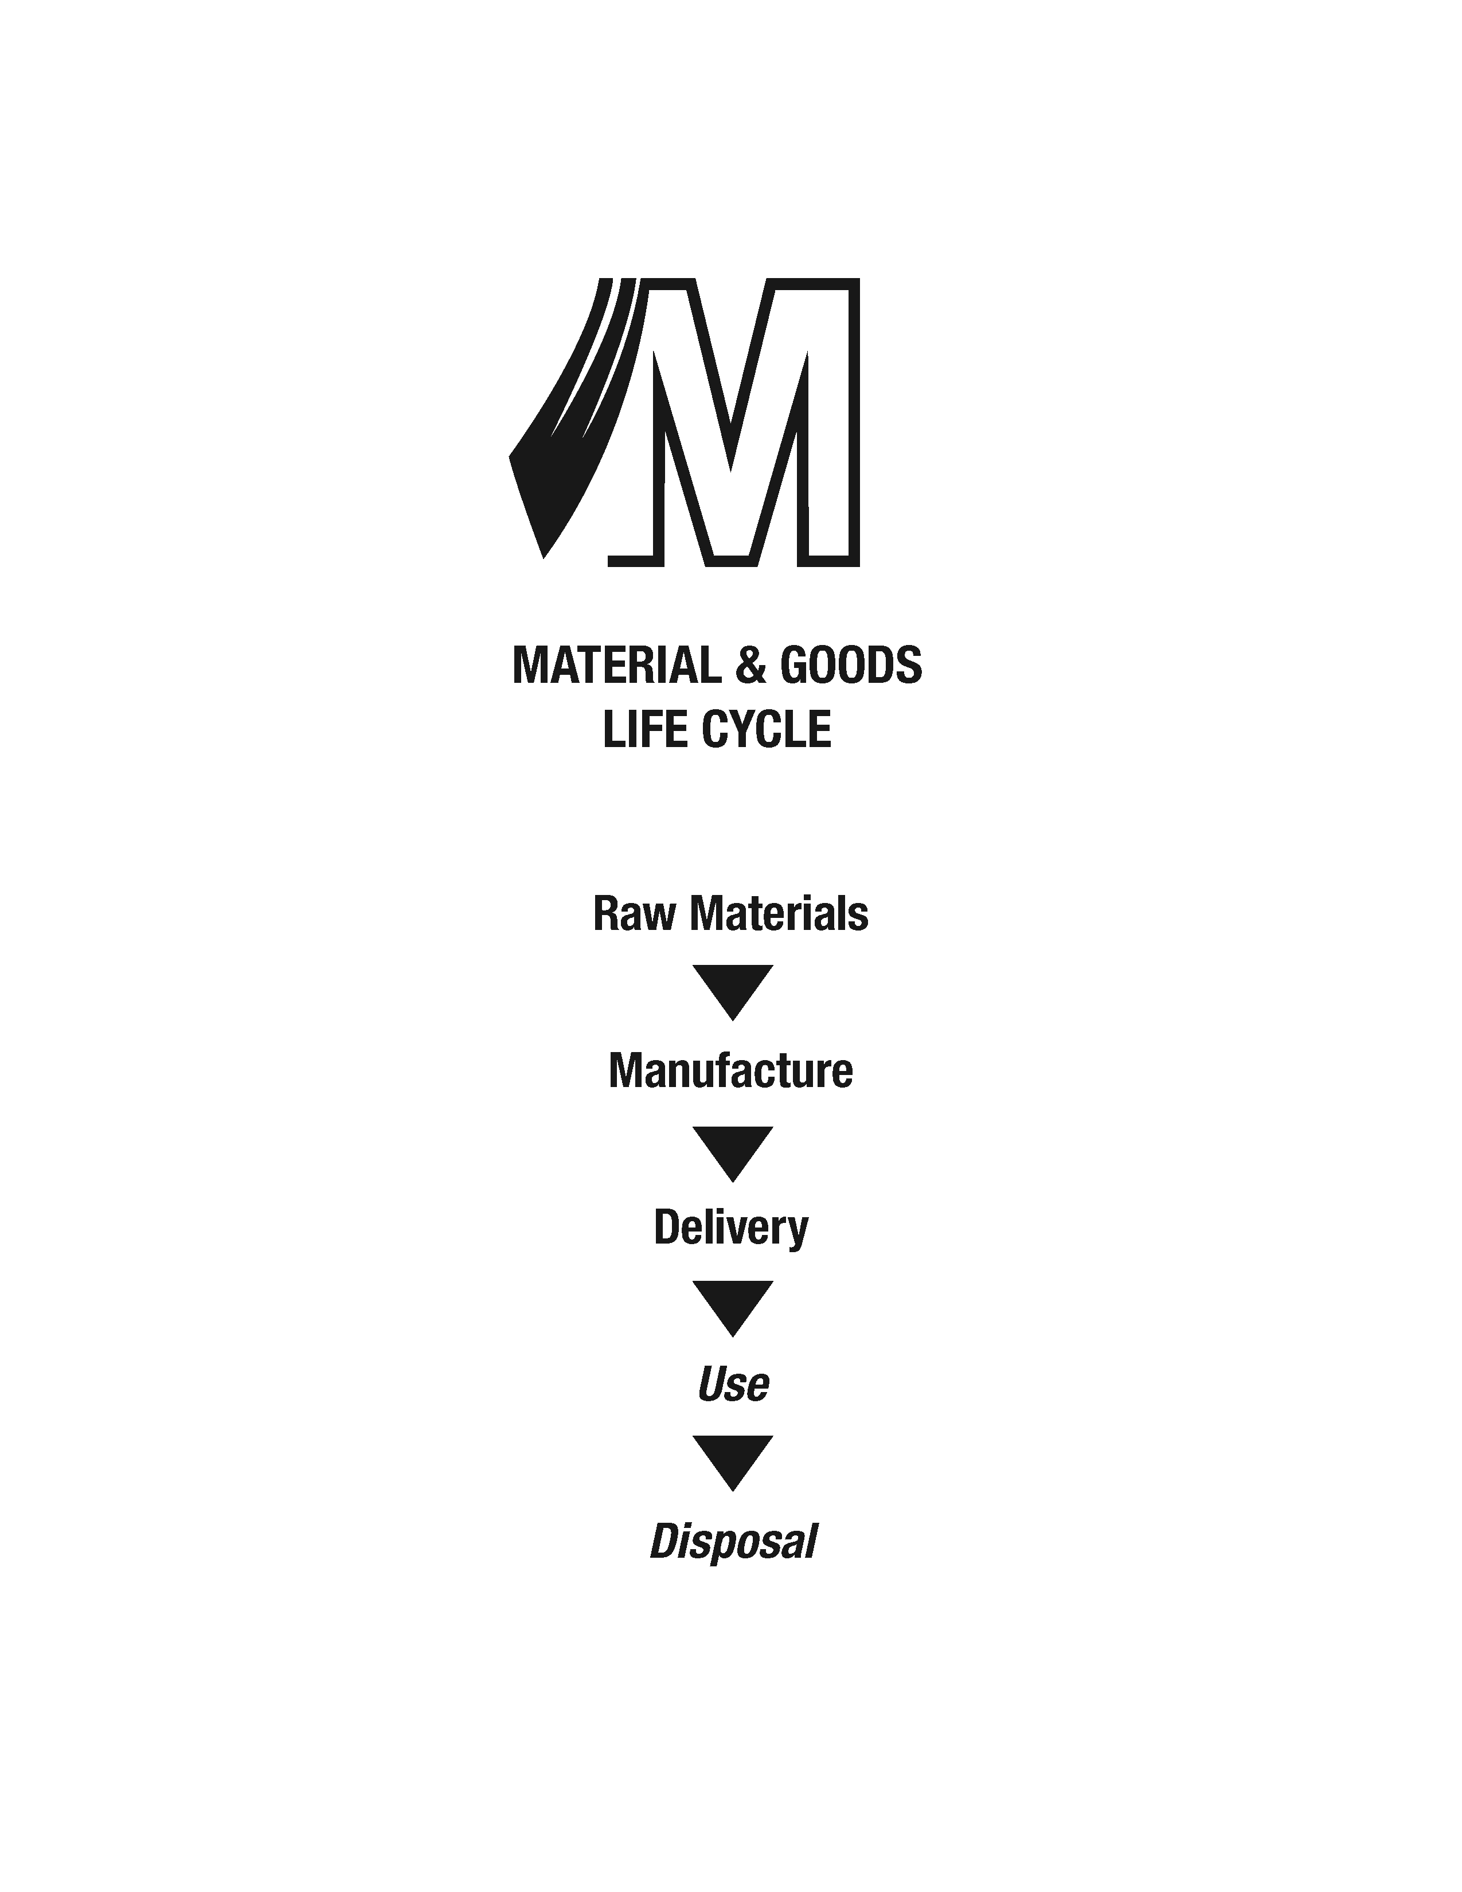
Methodology

Slide 6
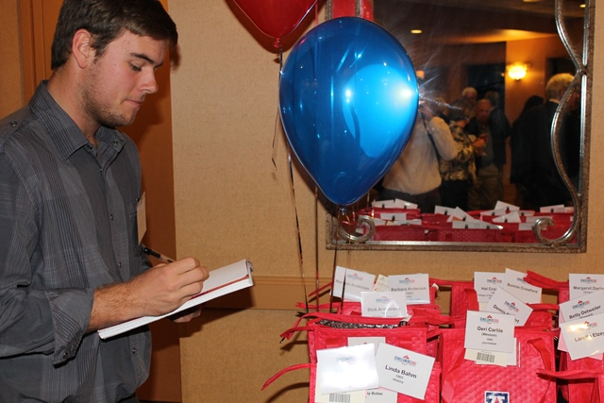
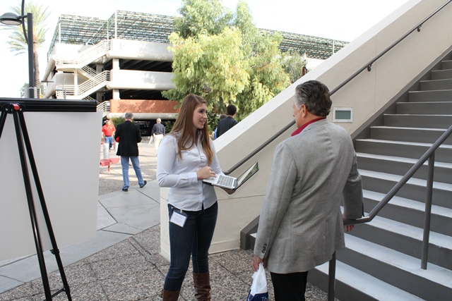
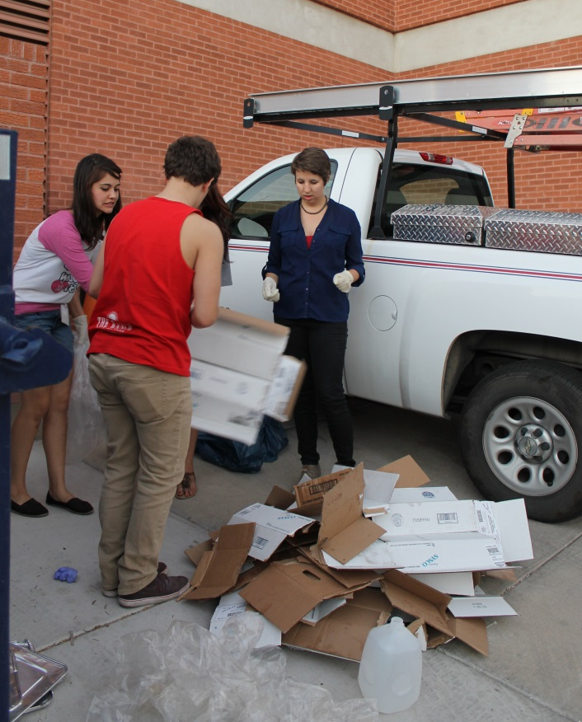
Methodology
Gathering Data

Slide 7
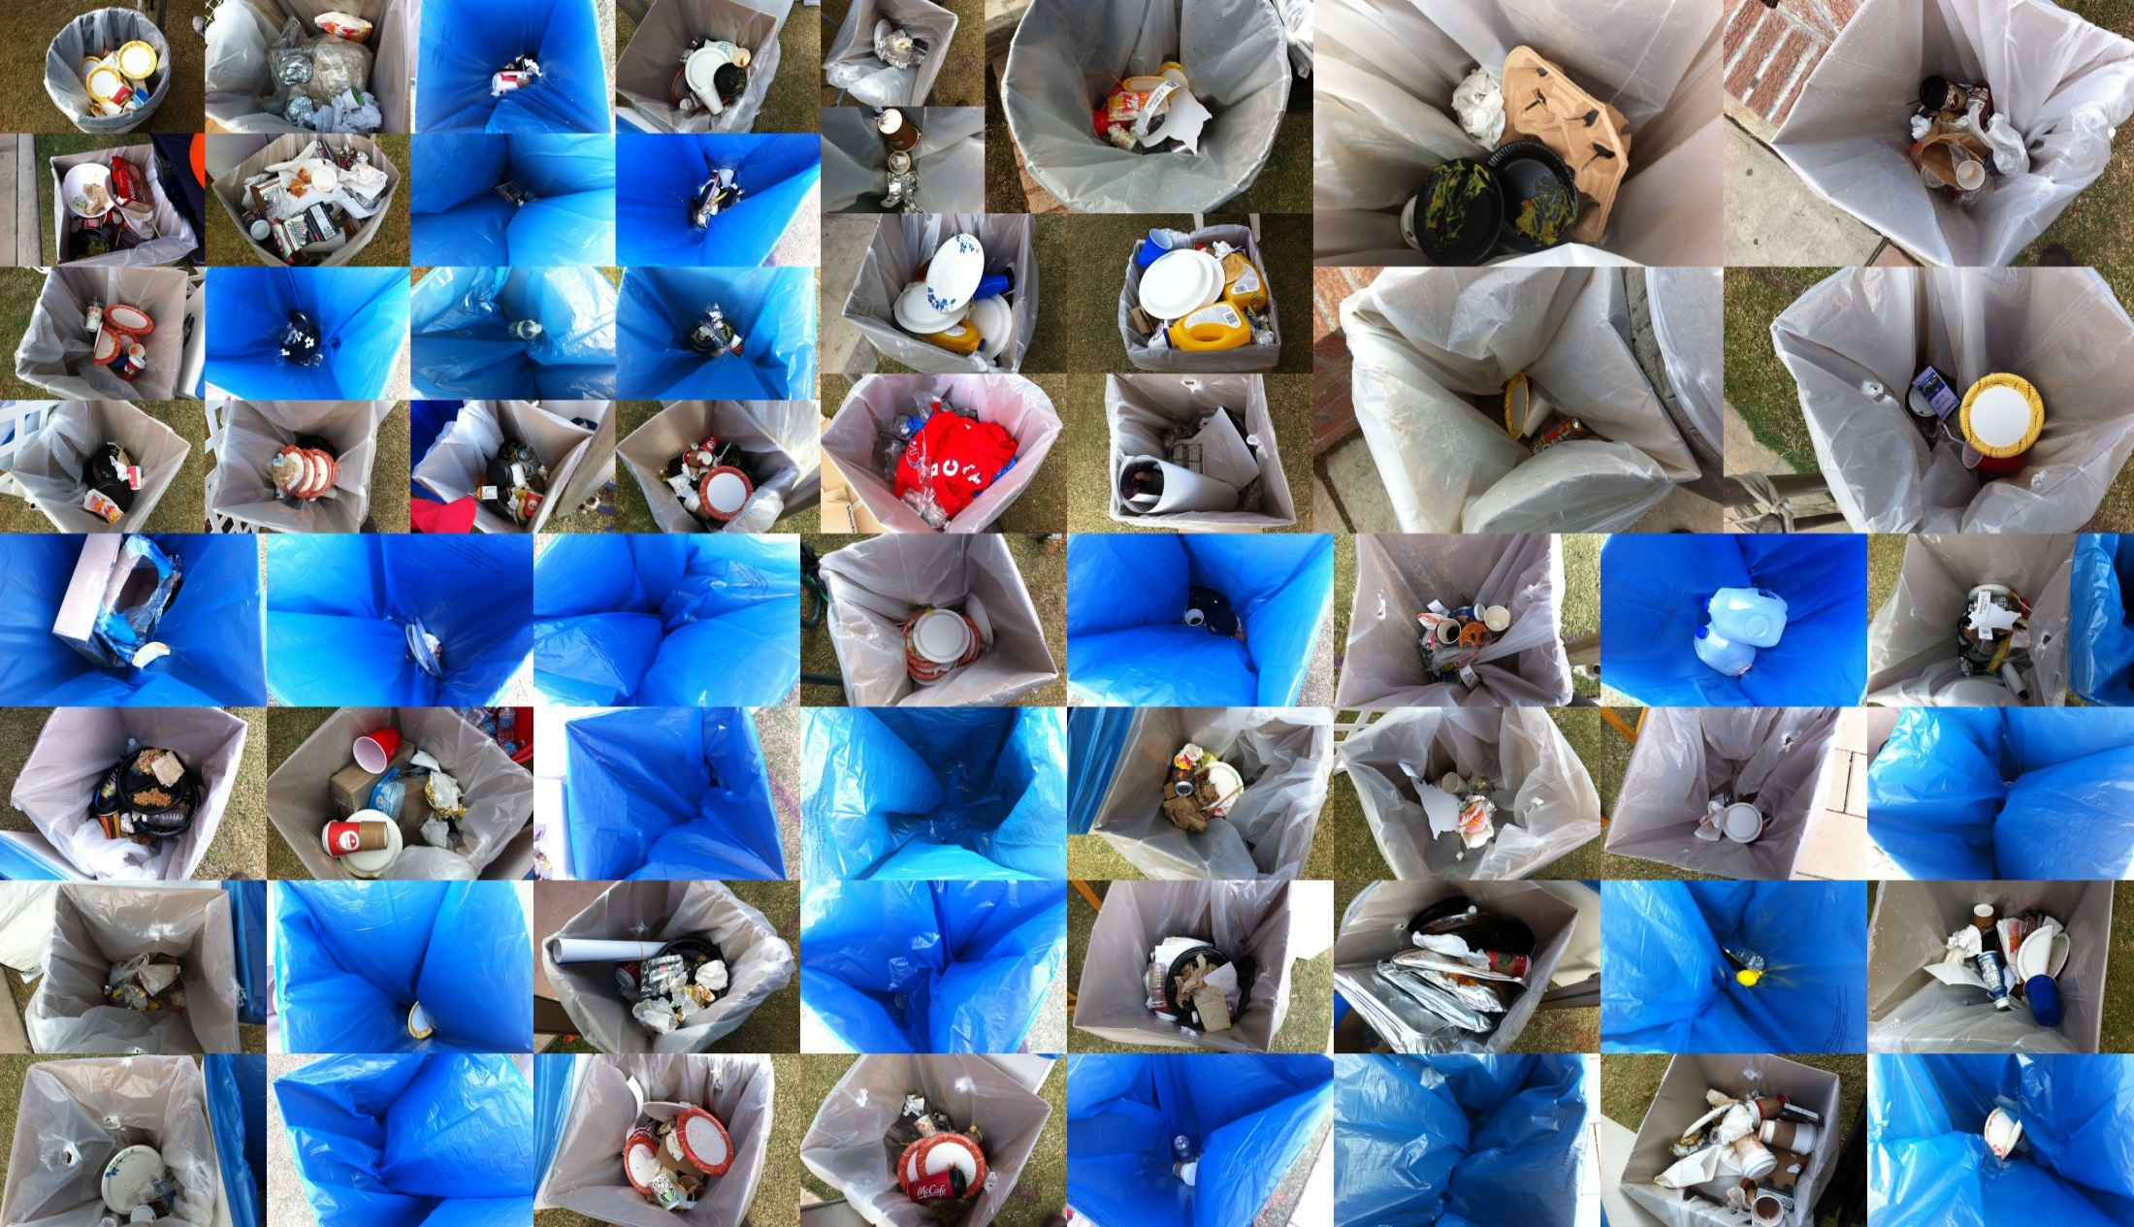
Impact of Waste

Slide 8
Impact of Waste

Slide 9
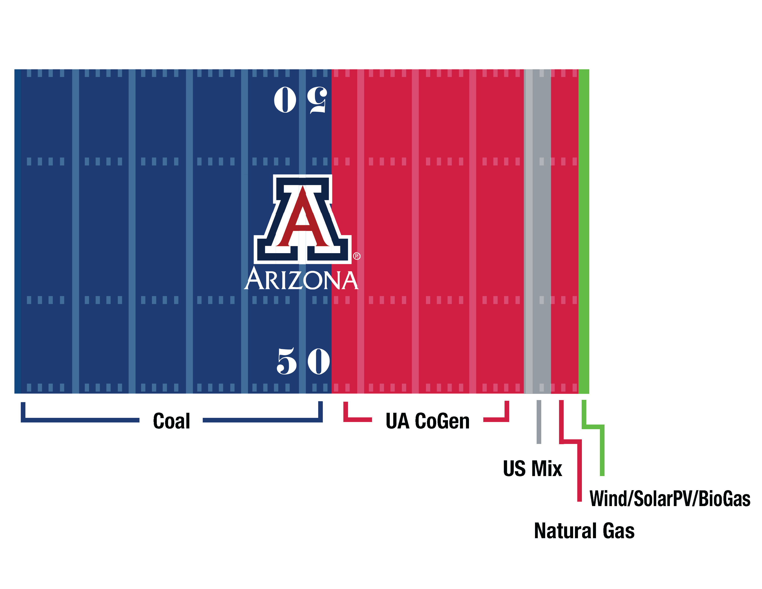
Impact of Energy
UA Power Generation Mix

Slide 10
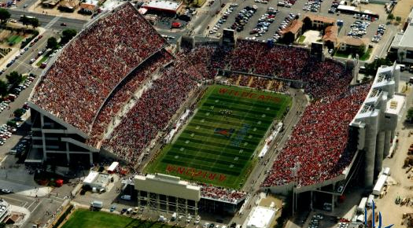
Impact of Energy

Slide 11
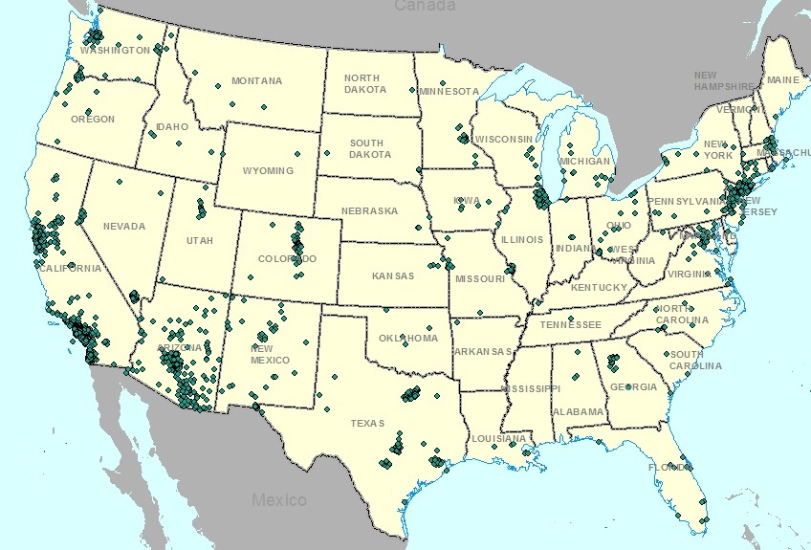
Impact of Travel

Slide 12
Impact of Travel

Slide 13
Total Impact of Homecoming

Slide 14

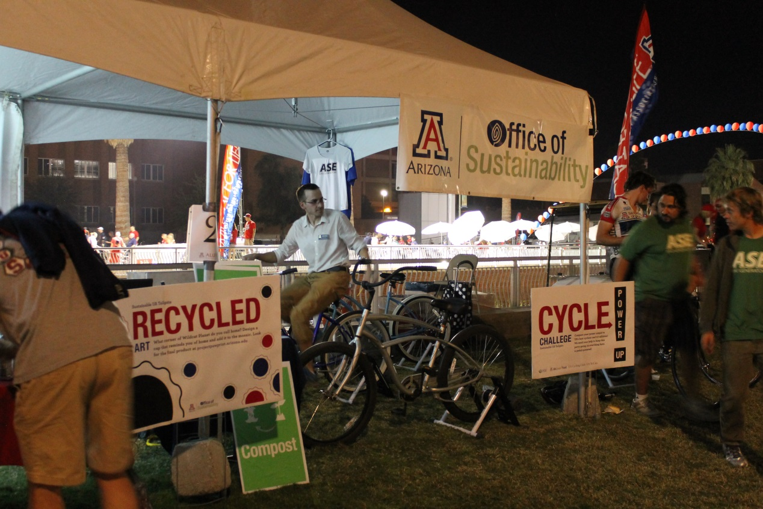
2013 Impact Mitigation Strategies

Slide 15

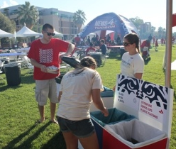
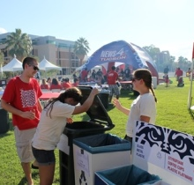
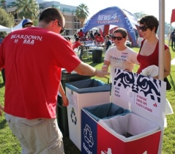
2013 Impact Mitigation Strategies

Slide 16
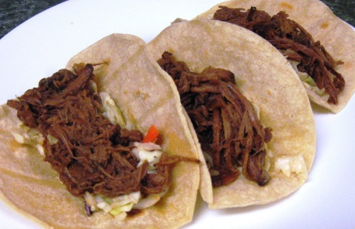
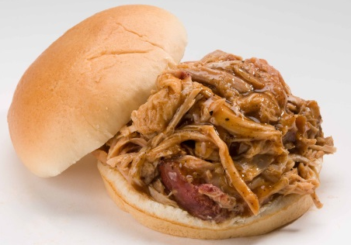
2013 Impact Mitigation Strategies

Slide 17
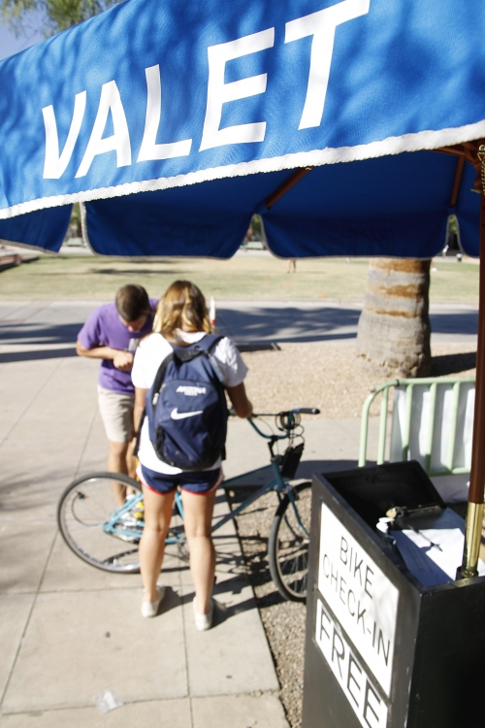
2013 Impact Mitigation Strategies

Slide 18
Summary and Conclusions
Quantifying environmental impact using life cycle assessments is challenging but beneficial
  Many different activities and types of impact to consider
Value Added through Impact Mitigation
PROJECTPAWPRINT.ARIZONA.EDU
  Actionable Data for Event
  Organizers, Campus Facilitators,
  External Partners, and Event Attendees

Slide 19
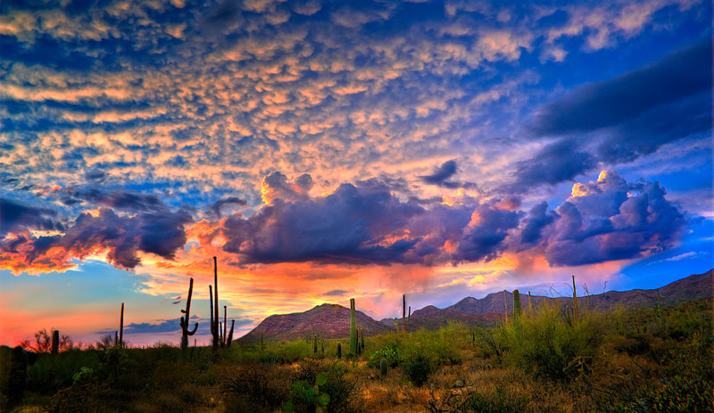
Thank You for Listening
Leah Edwards
ledward1@email.arizona.edu
UA Office of Sustainability
Notes:
Always end a presentation with a sunset!

Slide 20
Thanks to Everyone that Contributed
Students!
Student | Project Capacity |  | Student | Project Capacity
Sarah Appleby | Compost Cats |  | Jacob Lockwood | Data Collection/Management
Sarah Brunswick | Data Analyst |  | Julia Martin | Data Collection
Celeste Celletire | Data Analyst |  | Taylor Mason | Data Collection
Lauren Chon-Lopez | Data Collection |  | Jesse Minor | Administration
Leah Edwards | Data Analyst |  | Chet Phillips | Compost Cats
Kaitlyn Elkind | Greening the Game |  | Natalie Ramos | Social Media
Chelsea Ellis | Data Collection |  | Ysabella Rongo | Data Analyst
Danielle Goodman | Data Collection |  | Alex Ross | Visual Design
Christopher Hawkins | Data Collection |  | Ashley Sanders | Students for Sustainability
Paulina Jenney | Data Analyst |  | Jon Santos | Data Collection
Mykella Jones | Data Collection |  | Brendan Tobin | Image Processing
Maya Kapoor | Marketing/Copy Editing |  | Rebecca Veach | Solar Cats
Megan Kimball | Copy Editing |  | Entire MIS 111 Honors Class | Data Collection
Charles Lawry | Consumer Science
Notes:
Student involvement in research is the defining characteristic of this project. Many students with many different interests and abilities are required to perform an Event LCA

Slide 21
Thanks to Everyone that Contributed
Advisors! Partners!!
Advisors |  |  | Partners
Joe Abraham | Administration |  | UA Graduate College
Chris Baker | Surveys |  | UA Space Grant Program
Paul Blowers | Technical Advisor |  | UA Alumni Association
Robert Handler | LCA Software |  | UA Dining Services
Kate Jenson | Public Relations |  | ASUA Students for Sustainability
Leslie Johnson | Visual Design |  | Compost Cats
Bill Neumann | MIS 111 Prof |  | Greening the Game
Julia Rudnick | Administration |  | UA Athletics Ticket Office
Paul Tumarkin | Public Relations |  | UA Parking and Transportation
 |  |  | UA Honors College
 |  |  | Eller School of Business
 |  |  | Chemical & Environmental Engineering Dept.
 |  |  | Tucson University Park Marriott Hotel
Notes:
A list of the most involved advisors and Homecoming stakeholders/partners

Slide 22
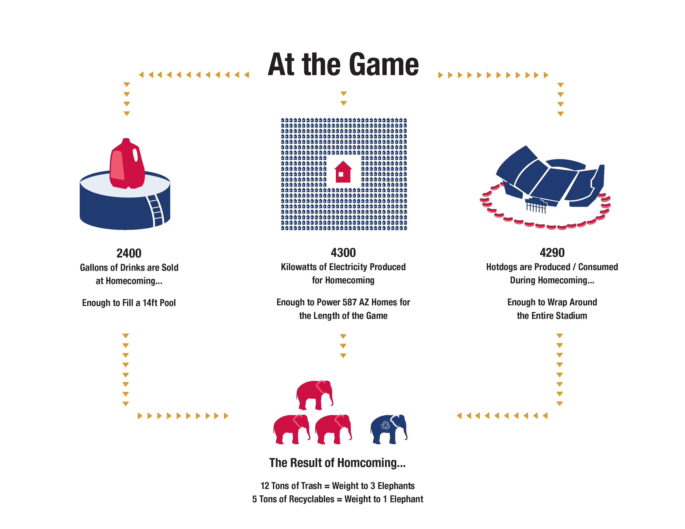
At the Game
Drinks Sold: 2,400 Gallons
Electricity Used: 4,300 kWh
Hotdogs Sold: 4,290
Disposed Materials:
12 tons Landfilled, 5 tons Recycled
Notes:
Interpretation of 2012 Results, continued

